Slide 1

Shareholders Presentation
17 May 2013

Slide 2
Highlights in 2012
Speedy achieved high revenue and profitability growth in a challenging market environment
The offering and development of new services continued
The capacity of the logistics hubs was significantly expanded
Maintained stable financial position and high profitability

Slide 3
Successful Strategy Implementation
Defending its leading position
Speedy remains the largest courier services provider in Bulgaria
The market share keeps on expanding at the expense of competitors
Customer orientation and service innovation
Focus on structuring the pallet services and international deliveries
Start of the program Speedy Parcel Shop
Investments in efficiency and flexibility
Over 800 000 BGN investments in technology infrastructure
Speedy achieved high growth in revenues and profitability in a challenging market environment

Slide 4
Strong organic growth
Local market revenues, BGN ‘000
International revenues, BGN ‘000
Number of parcels in ‘000
CAGR 14%
CAGR 17%
CAGR 47%

Slide 5
Operating expenses in line with the sales
Stable cost structure, with compensation costs and hired services accounting for the biggest chunk in the operating costs

Slide 6
Growing net cash flow
Speedy generates high free cash flow that allows for distributing more than 50% of its net income as a dividends.

Slide 7
Solid Financial Position
The high profitability allows to finance the organic growth and to maintain low indebtedness

Slide 8
Key Financial Indicators
2011
2012
Revenue growth
17,2%
19,7%
Maintain high growth
EBITDA Margin
19,88%
20,27%
Steadily improving margins
Net profit Margin
12,8%
14,0%
Profitability above market average
ROIC
47,8%
51,9%
Extremely high return on invested capital
Earnings Per Share
4,12 BGN
5,14 BGN
Net income 24,6% in 1 year
Debt / Equity
0,54
0,56
Sustainable debt structure
Dividend yield
5,68%*
Attractive dividend return
P / E
10,22х*
* Price as of 31.12.2012

Slide 9
Expectations for 2013
Market environment
The boom in e-commerce and outsourcing of logistic services are the key drivers of courier services growth
Sluggish economy does not allow significant growth of postal market in the current year
Revenues
The expected revenue growth for the current year is around 10%
The development of new products and segments, such as pallet business and international deliveries, are the main contributor for company development.
Costs and investments
Redirecting part of our activities to subcontractors will lead to changes in the cost structure.
Planned investments are in the amount of 6 – 6,5 million BGN, 60% of which in vehicles
Profitability
Investments in efficiency and reorganization will maintain the upward trend in the operating margin

Slide 10


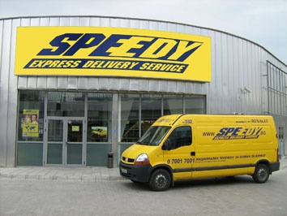
THANK YOU FOR YOUR ATTENTION!

