Slide 1
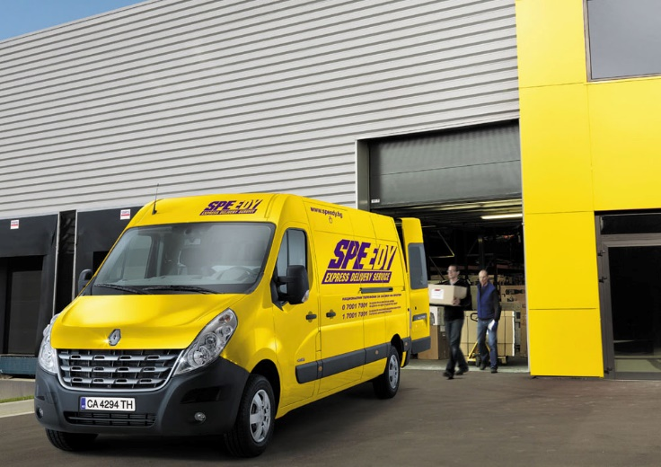
INVESTORS PRESENTATION
May 2017

Slide 2
HIGHLIGHTS
Market leader in Bulgaria, sizable presence in Romania
Logistic network covers 100% of Bulgarian and Romania servicing 1,3m customers
Market share of 38% in CEP market, 6,5% in Romania
Focus on the largest and best performing segment - business customers and e-commerce
Business model based on innovation, efficiency and quality
Highly advanced IT infrastructurE
Efficient HR management system
Service quality of 99.2%
Organic growth fueled by high profitability
Sustaining annual organic growth of c20% after 2010
Strong cash flow allows sustaining 50%+ dividend payout ratio
ROE bottomed at 16%
Geopost SA has a call option to acquire majority stake in 2020 at 8x EBITDA

Slide 3
KEY FIGURES
1 300 000+ unique clients
21 000+ corporate clients with contracts
350 offices in Bulgaria and 85 in Romania
25 000 000 deliveries
Part of GeoPost international network
Business Mix: B2B 47% , B2C 53%
100% coverage of Bulgaria, Romania and Greece
2400 employees and partners
Control over the fleet and network:
Over 1000 vehicles with capacity 1,5 t - 23 t
43 000 m2 distribution network and offices

Slide 4
LONG TRACK RECORD OF SOLID GROWTH
International deliveries and pallets in Bulgaria have increased almost 5 times since 2009 and account for more than 50% of the incremental sales
Core activity (parcels) keeps the pace and potential is far from exhausted.
EBITDA Margin in constant improve until 2014. The lower margins of DPD Romania shrunk the combined profitability
Margins deteriorate in 2016 and Q1 2017 following heavy investments in capacity and new services and higher expenses for salaries and subcontractors.
Acquisitions end 2014 contributed considerably to the sales

Slide 5
CONSTANT DEVELOPMENT ON SOLID GROUND
The rapid growth is not at the expense of the financial standing
Solid balance sheet provides the necessary base to sustain the pace of growth in long term
High ROE helps to maintain 50% payout ratio and to finance the growth
EUR 10m investments in 2016 increased the leverage
Company do not invest in real estate. It allows flexibility in operations and lowers capital intensity.

Slide 6
FAVORABLE MARKET ENVIRONMENT
5-years cumulative market growth of 33% makes it very dynamic as well as competitive.
Currier services are the blood system of the booming e-commerce
Large number of registered companies but top 10 account for 86% of total volumes, Econt being our largest competitor.
Well diversified , Speedy is a leader in large parcels and with a strong presence in international deliveries and e-commerce.
Romanian market shows high potential and much larger share of cross-border orders
Market share of around 6.5% in Romania, targeting top 3
Large multinationals are key competitors dominate the international deliveries

Slide 7
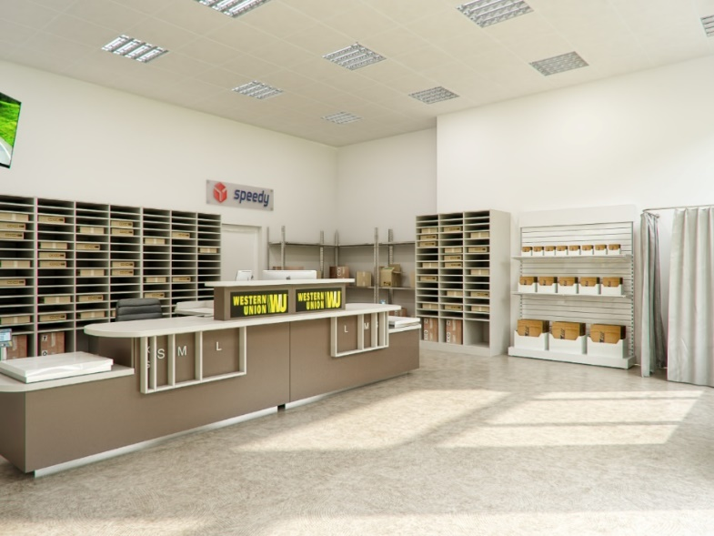
OUR STRATEGY
Focus on core business, diversification of services
Virtually all revenues come from core business
Adding wide variance of services that add value and satisfaction for the clients
Resources are channeled in services where Speedy has a competitive advantage – large parcels, corporate clients
Constant innovation and improvement
Implementing technologies on every possible level – 90% of the orders are processed through on-line platform completely automatically.
Exploring and introducing the best available practices
Exploiting the first mover advantage and services with potential
Introducing to the market new services – international overland deliveries and pallets has contributed for around half of the incremental revenues in the last years and currently account for 30% of total sales
Creating regional market with Speedy Balkans
Large office network makes Speedy a key player for online traders

Slide 8
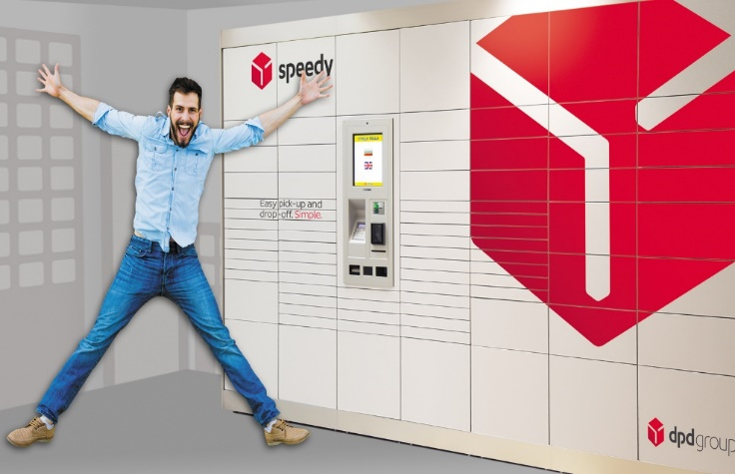
POTENTIAL IS NOT EXHAUSTED
Operations based in one of the fastest growing economies in Europe. With 15% and 30% higher sales in Bulgaria and Romania , respectively, potential does not looks exhausted.
Booming e-commerce.
Long-term prospects in pallet services.
Exclusive rights to offer DPD services in Greece. Access to DPD network and partnership with companies in neighboring countries help further growth in international deliveries.
Investments in web-based products and new equipment enable cost savings and new services.
Economy of scale is a huge advantage.

Slide 9
SEARCH FOR OPTIMIZATION
In 2014 Speedy executed a major change in its strategy – the logistic activities from predominantly in-house were largely outsourced
Costs structure changed with subcontractors taking the largest shares at the expense of fuel, maintenance and remuneration
After restructuring on non-consolidated bases EBITDA Margin hit a peak of 21% in 2015.
Fast growth and intensive investments put costs under pressure. Our expectations are margins to recover once investments and size starting paying off.

Slide 10
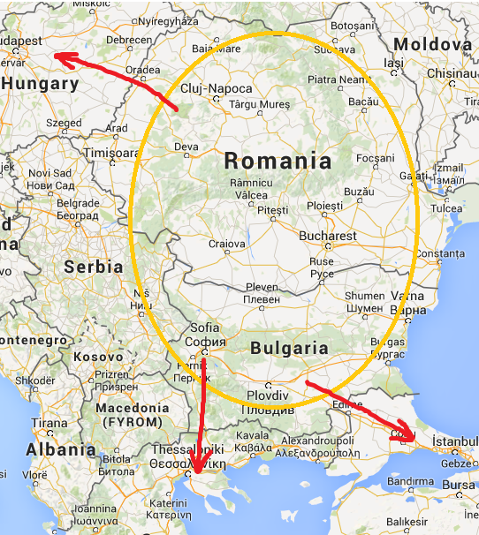
OUR VISION
Wide range of courier and logistic services.
Local market: City, Express, Economic
Integrated regional market: Bulgaria, Romania, Greece
To and from Europe

Slide 11
BUILDING TRUST
PARTNERSHIP ATTITUDE TOWARDS ALL STAKEHOLDERS
Promises during the IPO in 2012 | Fulfillment
Acquisition in Romania and regional expansion
Attracting strategic investor
Annual sales growth above 10%
At least 50% dividend distribution – set in the Article of Incorporation
Responsible corporate governance

Slide 12
OUR VALUES
TRUST
QUALITY
RELIABILITY
OPENNESS
ENTHUSIASM
LEADERSHIP
POSITIVISM
PROFESSIONALISM
GRWOTH
RESPONSIBILITY
LOYALTY
SECURITY
ETHICS
SPEED
DEVELOPMENT
SOCIAL RESPONSIBILITY
POTENTIAL
PARTNERSHIP

